Slide 1
Cornerstone City Church Peninsula Plus Community Hoo Are Ya
5th May 2025

Slide 2


Slide 3


Slide 4
Turn It Up
CCLI Song # 6621485
Andy Harrison
© 2012 Planetshakers Ministries Int. Inc. (Admin. by Song Solutions www.songsolutions.org)
For use solely with the SongSelect® Terms of Use. All rights reserved. www.ccli.com
CCLI Licence No. 33265

Slide 5
1/6
You are here as we lift You up
You are riding on our praise
Be enthroned over everything
You are seated in our praise

Slide 6
2/6
This is prophetic I can feel it in the air
We lift our praise and You change the atmosphere
With hearts open now everybody singing out
(Oh)
(I am free)

Slide 7
3/6
Turn it up this sound of praise
Make it louder than any other
Lift Him up and shout His name over all

Slide 8
4/6
As we praise I can feel the change
As Your presence now invades
Hear the sound of the broken chains
Prison doors are giving way

Slide 9
5/6
Our praise goes up
Your rain comes down
(REPEAT)

Slide 10
6/6
With shouts of praise we celebrate
King of glory enter in
You are riding on our praise oh Lord

Slide 11
Thanksgiving
CCLI Song # 7199589
Nick Herbert | Taku Mudere | Zo Chilengwe
© Capitol CMG Genesis; Safe and Sound Music; Remaining portion is unaffiliated
For use solely with the SongSelect® Terms of Use. All rights reserved. www.ccli.com
CCLI Licence No. 33265

Slide 12
1/8
Enter in (Enter in)
His courts with praise (His courts with praise)
For He is greatly (He is greatly)
To be praised (To be praised)

Slide 13
2/8
What shall we do
We shall lift up a shout
What shall we do
We shall praise Him
What shall we do
For our God made a way
We'll give Him our thanksgiving

Slide 14
3/8
Magnify (Magnify)
His Holy Name (His Holy Name)
For He is greatly (For He is greatly)
To be praised (To be praised)

Slide 15
4/8
What shall we do
We shall lift up a shout
What shall we do
We shall praise Him
What shall we do
For our God made a way
We'll give Him our thanksgiving

Slide 16
5/8
Even if the rocks cry out
We're gonna drown them out
With a louder shout of praise
Even when the battles roar
We're gonna praise You Lord
'Cause You are always worthy

Slide 17
6/8
You are worthy
Worthy of honour and praise
You are worthy
We'll sing it again and again

Slide 18
7/8
What shall we do
We shall lift up a shout
What shall we do
We shall praise Him
What shall we do
For our God made a way
We'll give Him our thanksgiving

Slide 19
8/8
We'll give Him our thanksgiving
We'll give Him our thanksgiving

Slide 20
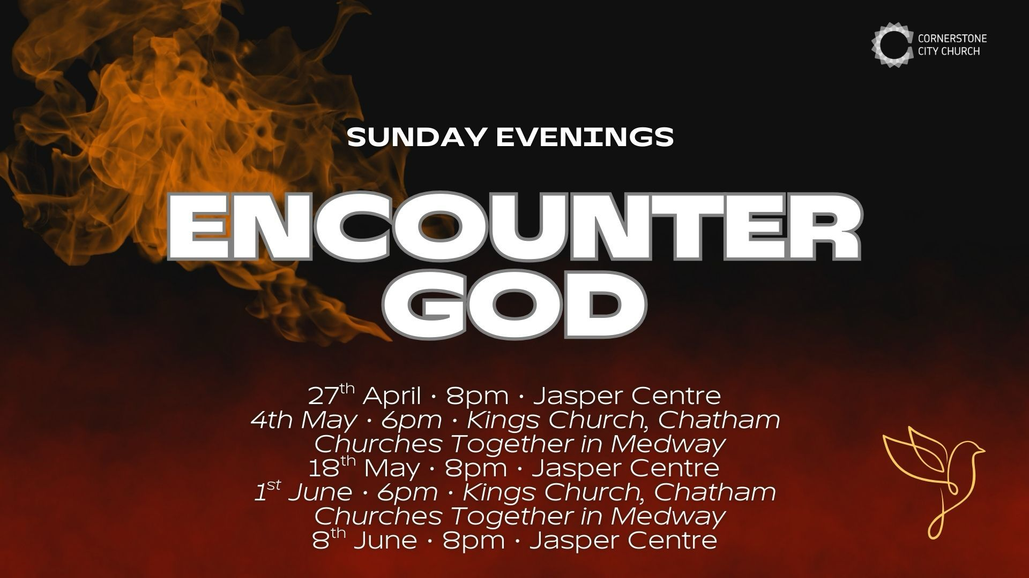

Slide 21


Slide 23

Grow Group 1
On YOUR MARK!

Slide 24
Leaders
Leaderss
Phil & Kim
Maria (Mia) Warren
Matthew Harrison
Richard & Elisha Acheampong
Phil & Kim
Maria (Mia) Warren
Matthew Harrison
Richard & Elisa Acheampong

Slide 25

Storm Walker
Storm Walker
Symbolising, trust in Jesus Christ through life's storms.
Mark 4:35-41

Slide 26


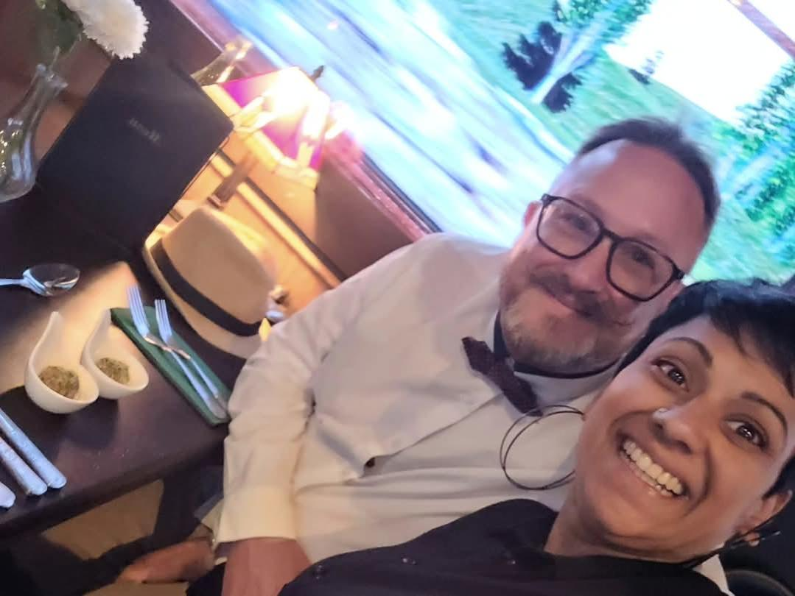
Group Leaders
Micheal and Mwamba
Wilfred and Parveen
Hannah

Slide 27
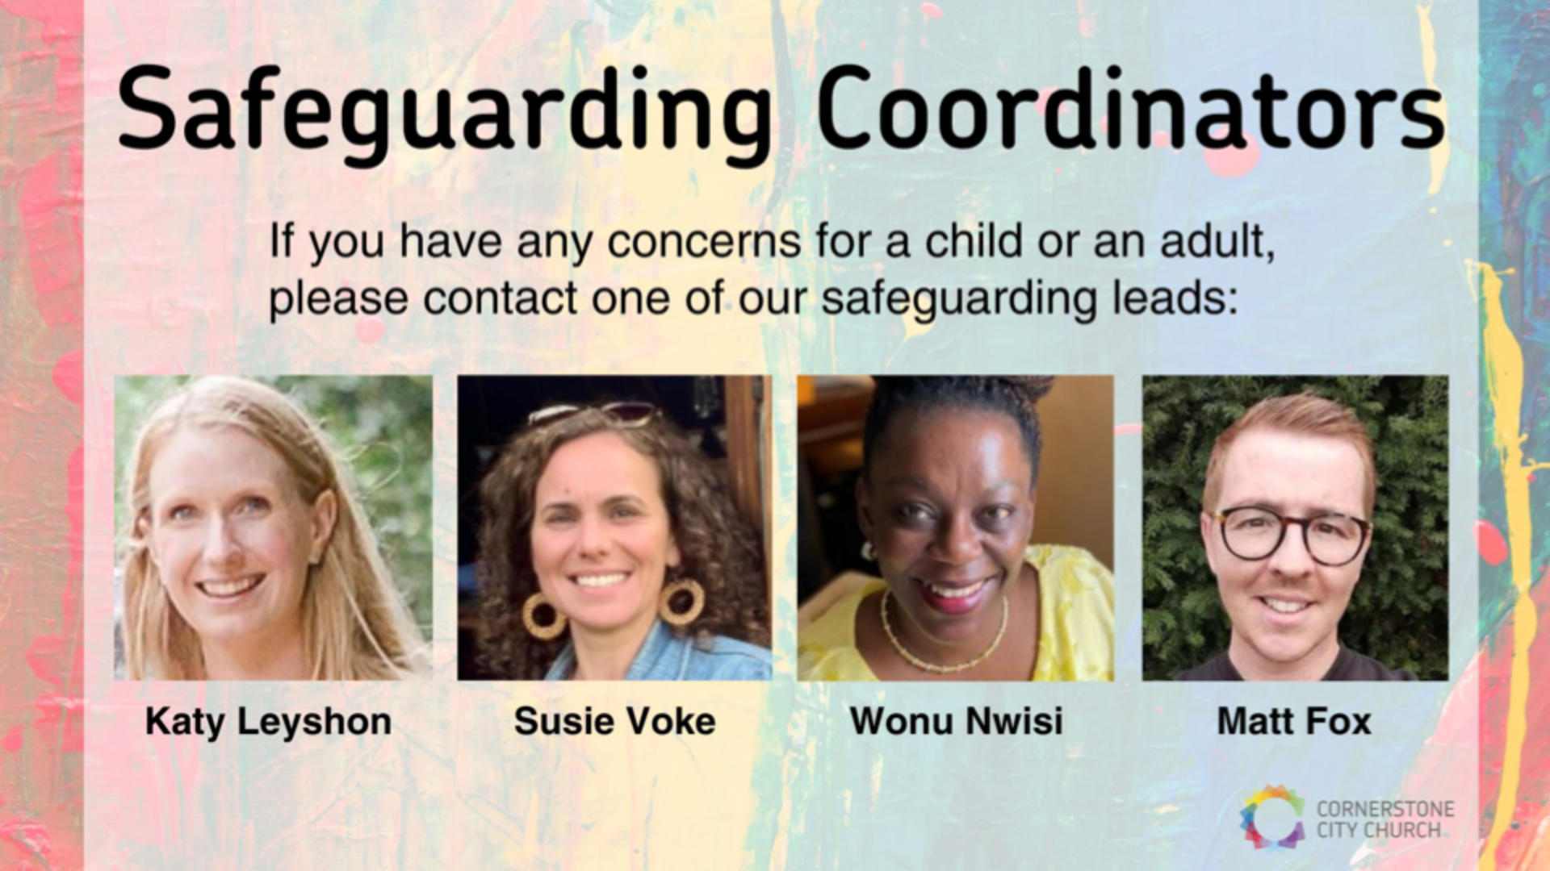

Slide 28
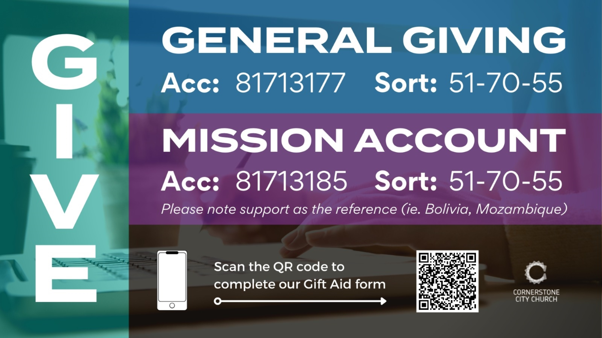

Slide 29


Slide 30
2 Corinthians 14 May the grace of the Lord Jesus Christ, and the love of God, and the fellowship of the Holy Spirit be with you all
Surely goodness and mercy shall follow me all the days of my life, and I shall dwell in the house of the Lord forever.

